Slide 1
TRL vs IRL
Centrifugal Cream Separation
From Scientific Discovery to Investment Decision

Slide 2
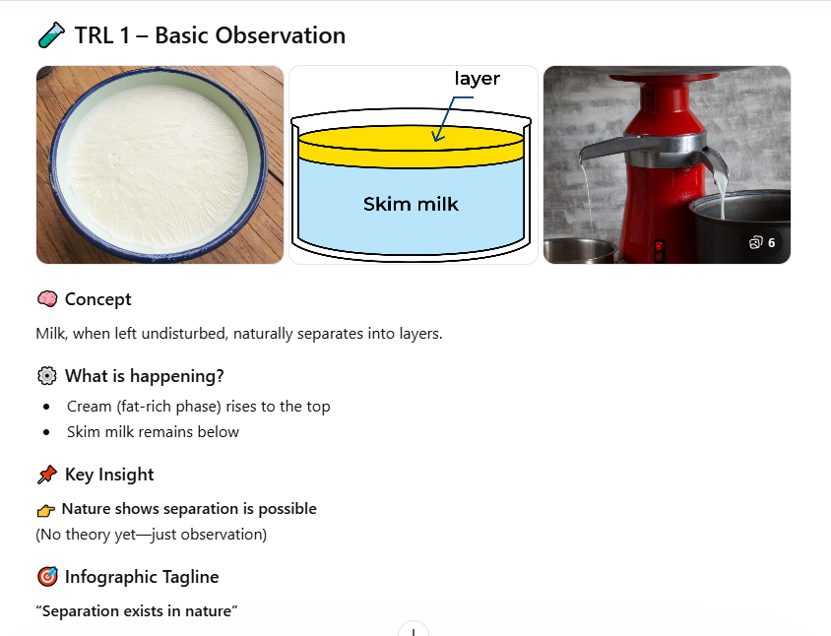

Slide 3
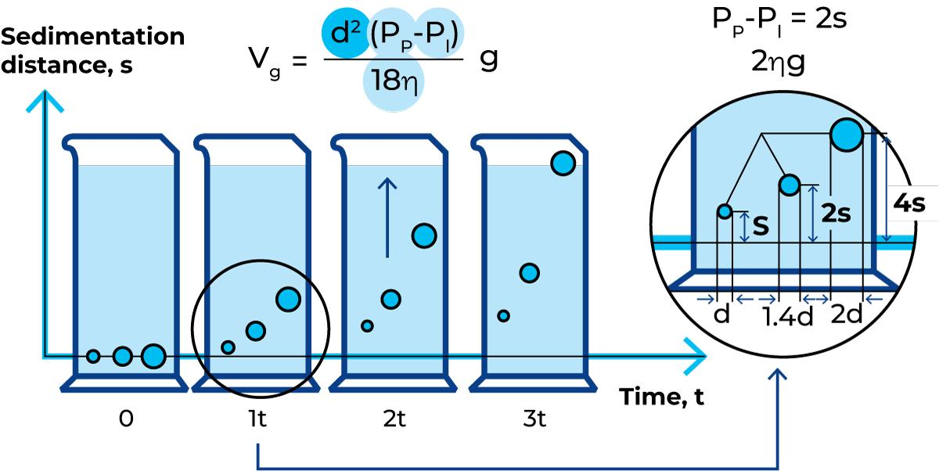
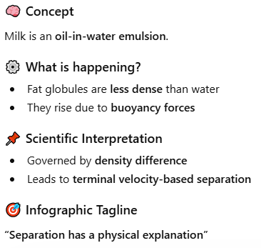
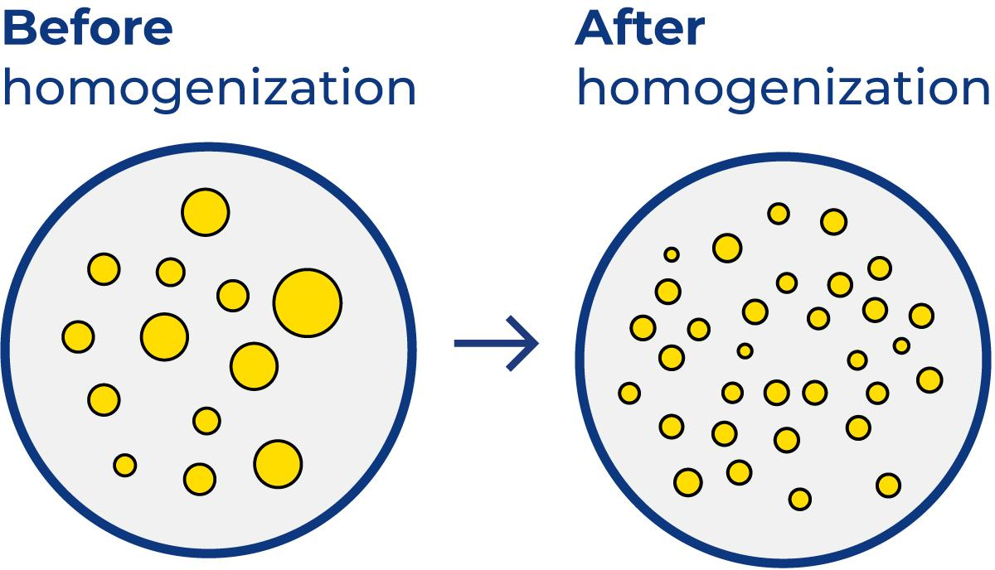
TRL 2 – Concept Formulation

Slide 4
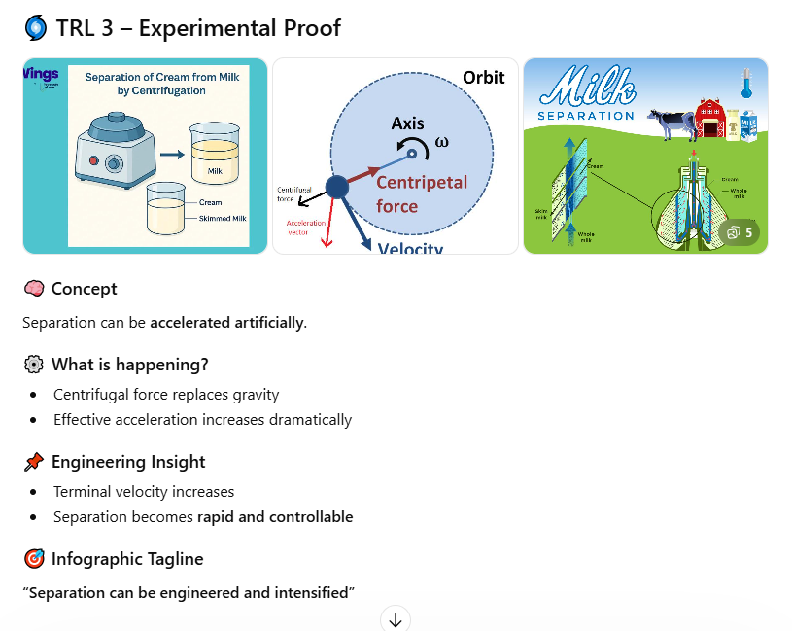

Slide 5
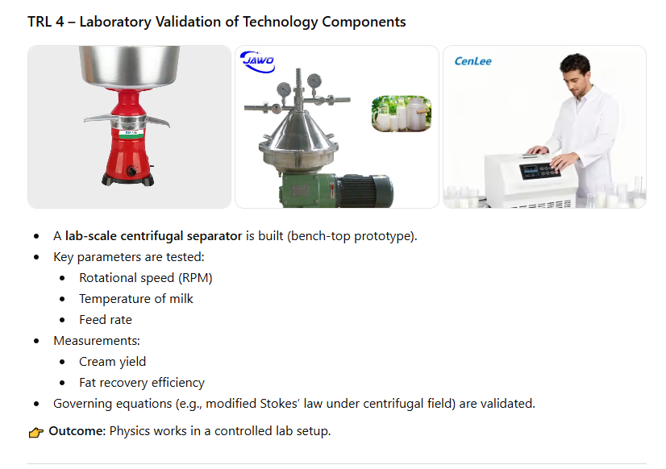

Slide 6
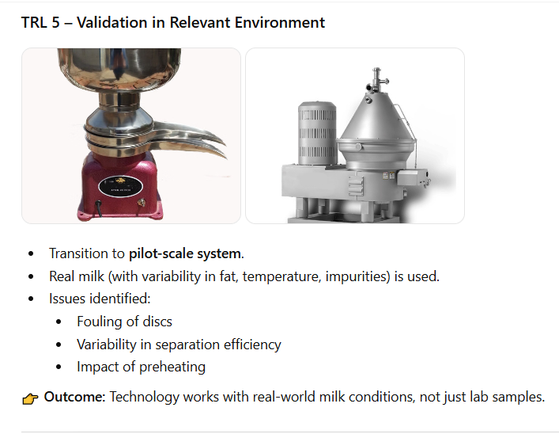

Slide 7
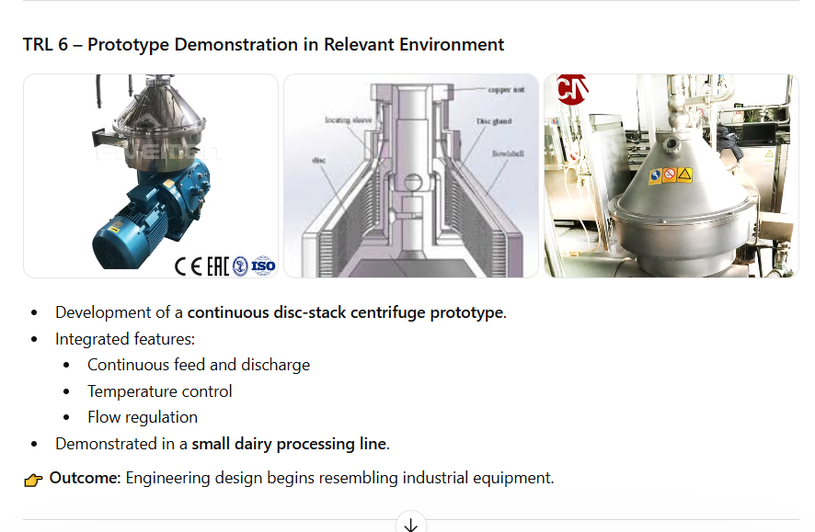

Slide 8
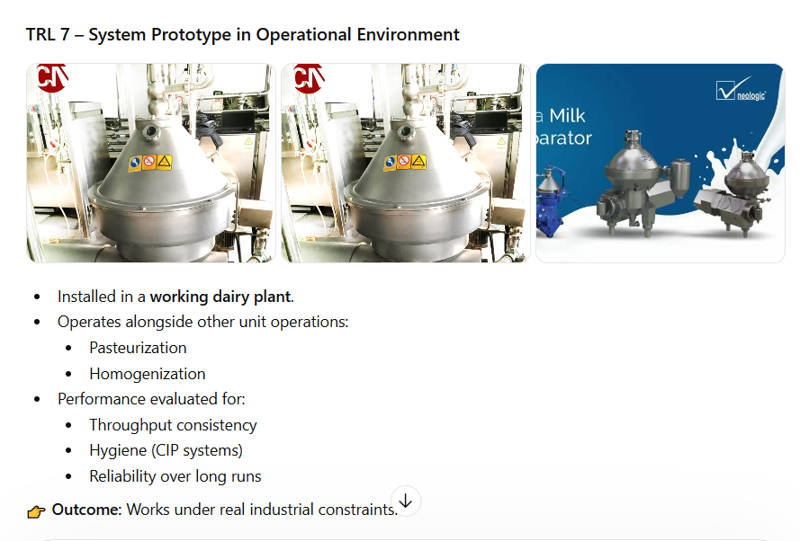

Slide 9
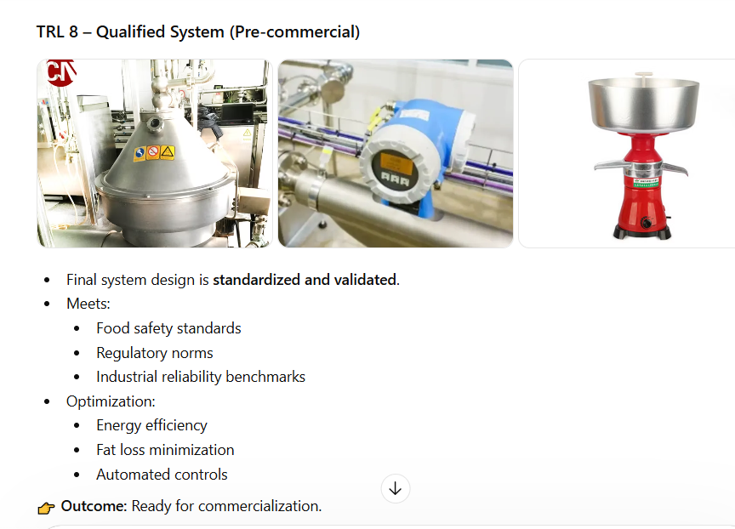

Slide 10
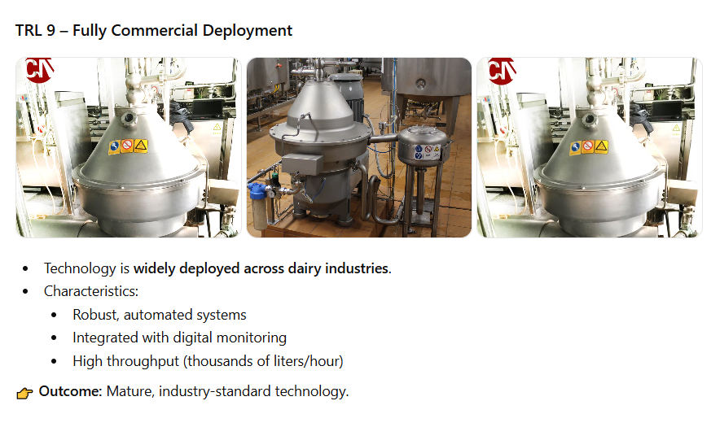

Slide 11
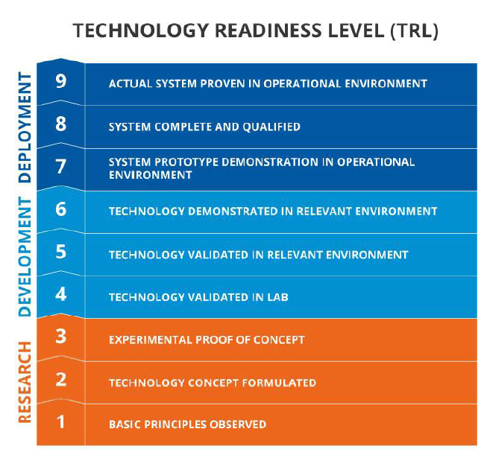

Slide 12
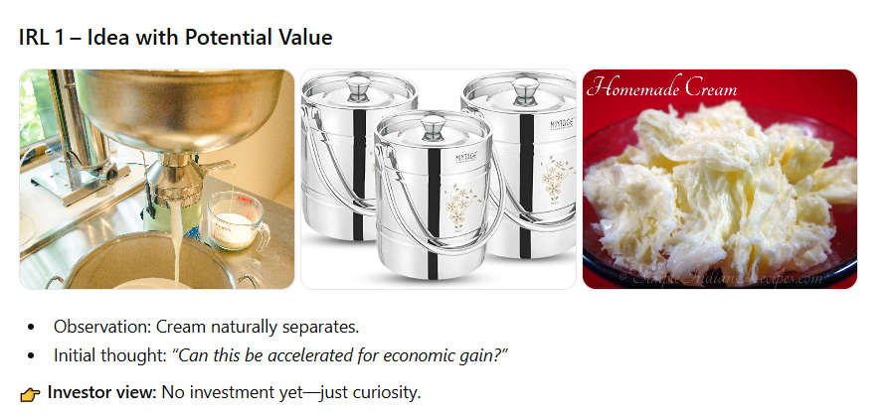

Slide 13
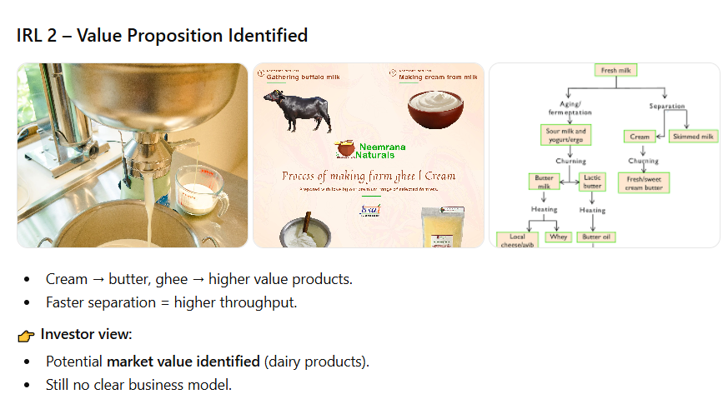

Slide 14
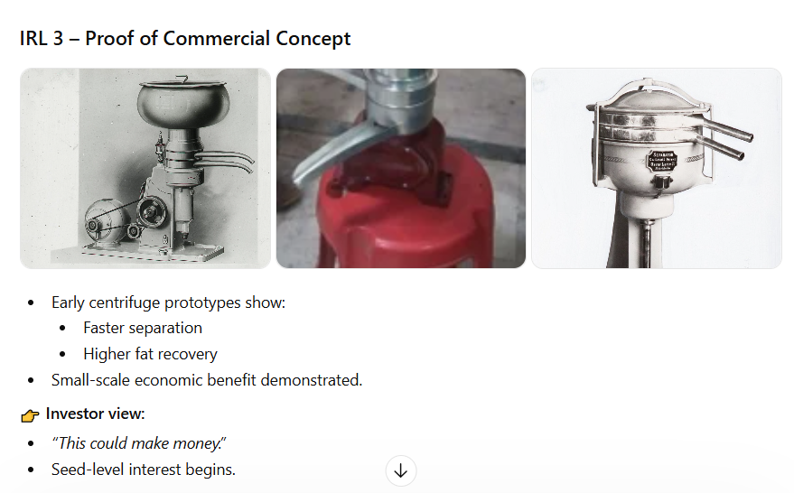

Slide 15
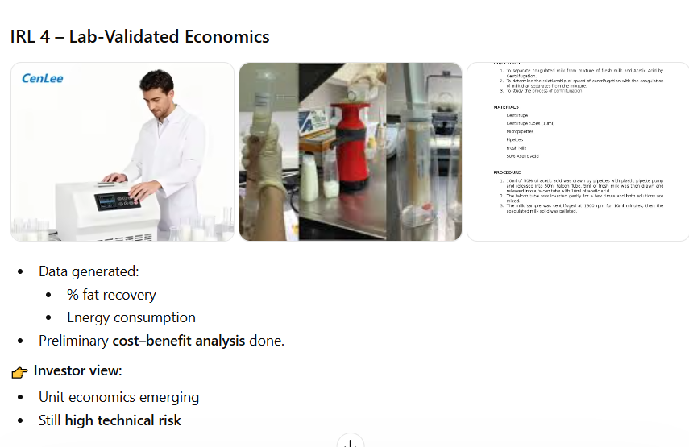

Slide 16
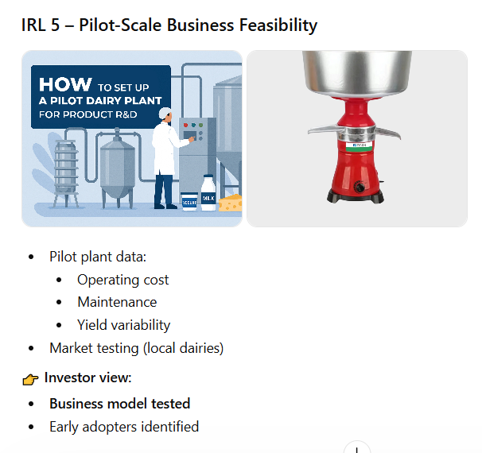

Slide 17
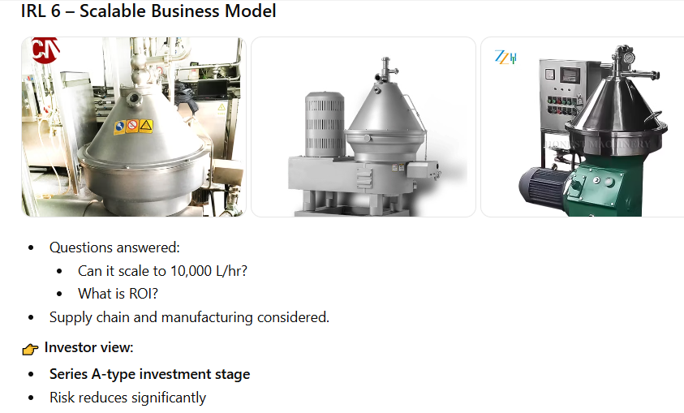

Slide 18
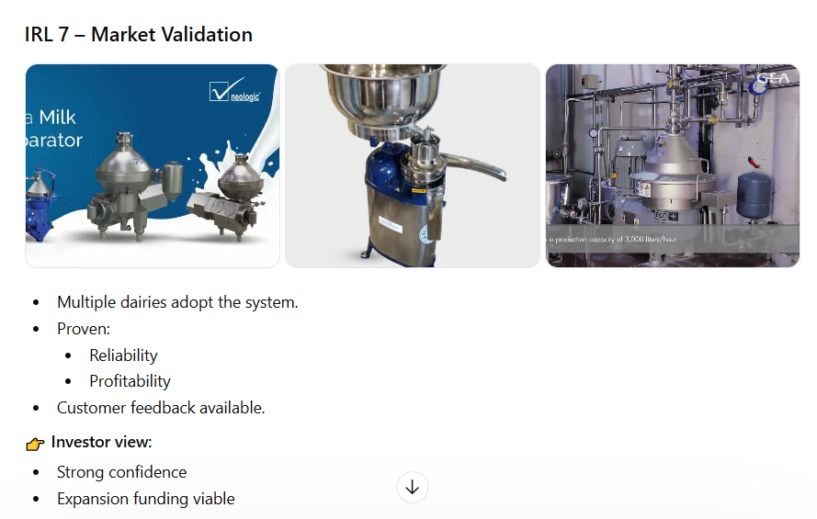

Slide 19
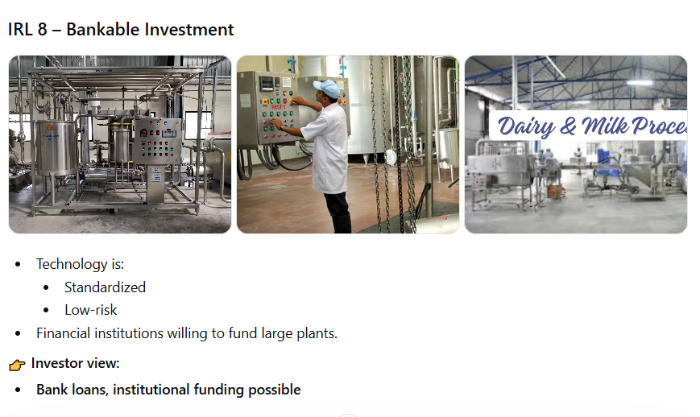

Slide 20
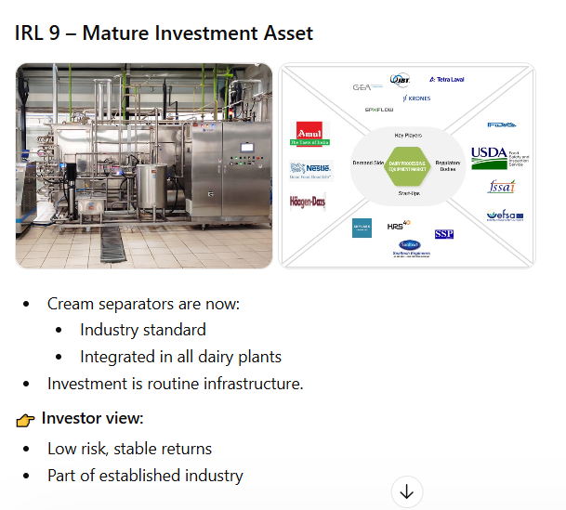

Slide 21
Investment Readiness Level (IRL): Idea-to-Start-up-to-VC
IRL.1 Basic Research (Need Identification & Peer Review Publications) & Completed First-Pass Business Model Canvas (BMC)
IRL 2 Applied Research (Market Size and Competitive Analysis) & Business Plan - Value Propos1tion & IP Identification
IRL 3 _Validate Problem - Solution Fit (Confirmed Value Proposition & Techno-Economic Analysis) & Minimum Product Cost (Maturity of Core Technology
IRL 4 Prototype Low-Fidelity Minimum Viable Product (MVP): Low-fidelity: A representative of the component or system that has limited ability to provide anything but initial information about the end product
IRL 5 Validate Product-Market Fit (Integrated Validation of the Minimum Viable Process and Process Engineering). "High-fidelity" - A high-fidelity laboratory environment would involve testing with equipment that can Simulate and validate all system specifications within a laboratory setting.
IRL 6 Validate Business/Revenue Model: Integrated Pilot Development – understanding operational nuances
IRL 7 Prototype High Fidelity MVP Integrated Pilot Continuous Operation
IRL 8 Pre-Commercial Demonstration - Operating Conditions and quality stabilized
IRL 9 Full Commercial Development - A full time process engineering staff continuously verifies that operations are meeting cost, yield and productivity targets.

Slide 22
TRL vs IRL
TRL: Does the technology work?
IRL: Is it worth investing?
TRL driven by engineers
IRL driven by investors
Both must align for success

Slide 23
SRL–TRL Mapping Table
Software Stage (SRL) | Typical TRL Range | Interpretation
Pre-Alpha | TRL 2–3 | Concept and proof-of-concept code
Alpha | TRL 3–5 | Core functionality, unstable, lab validation
Beta | TRL 5–7 | Real-world testing, user feedback
Release Candidate | TRL 7–8 | Near production, minor fixes
Production | TRL 8–9 | Fully deployed, stable system

Slide 24
THANKS

